Slide 1
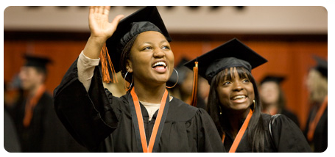
But nobody told me this!
Planning for success
Mario Borunda and Girish Chowdhary
(The advise I whish I had been told)

Slide 2
OUTLINE
Setting goals
The ideal student: skills to develop
Getting to your goals; it is more than great science:
Don’t count on luck, help luck meet you
What to do, what to focus on, what to prioritize?
You are ALWAYS interviewing
Self examining progress, seeking help when needed

Slide 3
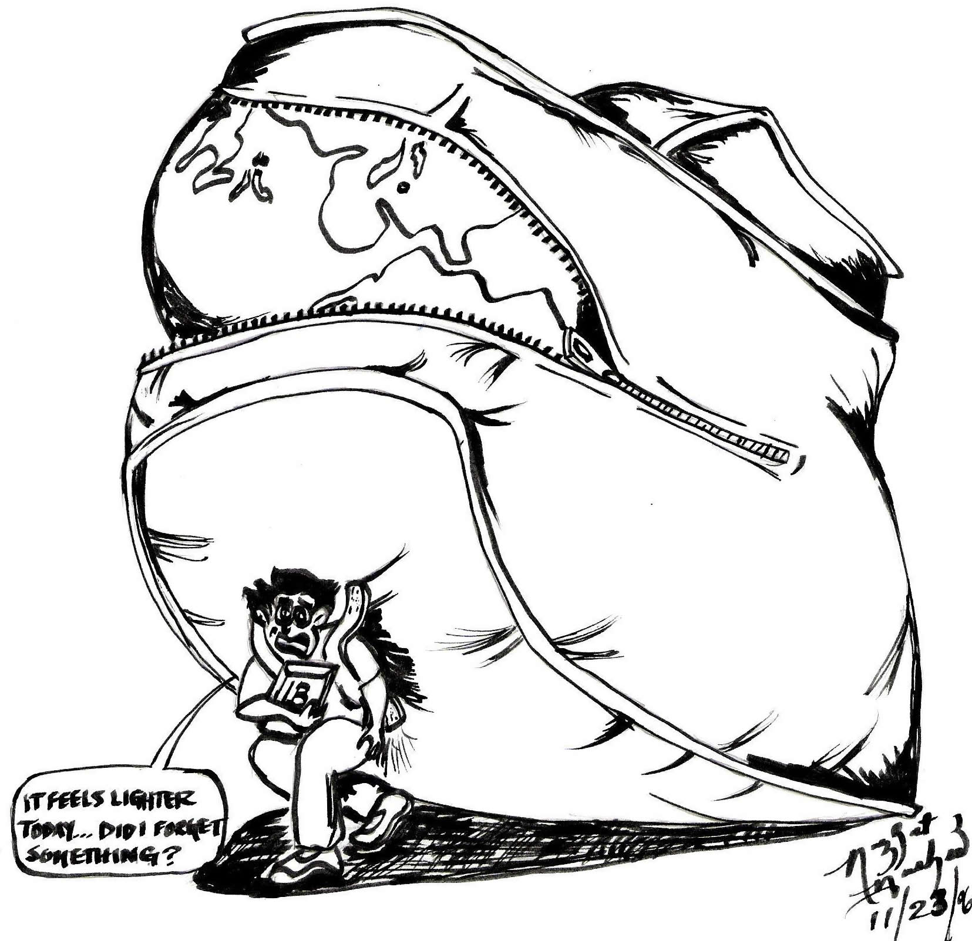
Key skills to develop
The ideal student
Competence in research field
Confidence as a critical thinker
Skillful communicator at all levels
Able to contribute as a team player
Creative
Able to execute new ideas
Takes initiative and charge…
while balanced with measured risk
Broad research exposure
Networks efficiently

Slide 4
Getting to your goals (how to go about doing it)
Competent in her research field
Courses are not things to pass
Courses are needed material needed to be creative and execute
Go beyond courses
Create a list of ‘what I need to know’ to complete projects
Make a plan and a schedule to acquire that knowledge (mini-courses, reading club, ask for specialty course…)
Getting to your goals: Skills are not innate

Slide 5
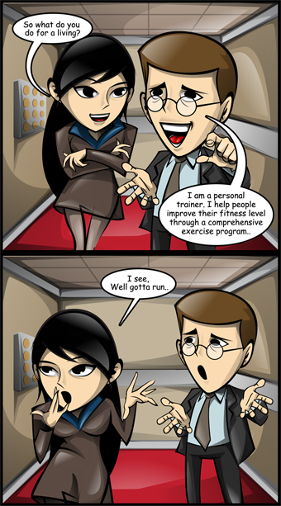
Getting to your goals (how to go about doing it)
Skillful communicator at all levels
Practice, practice, and practice at every opportunity. Public speaking is HARD.
Study great speakers, what they do and why they are successful.
Your science and why it is exciting is key!
Have a 1, 5, and 15 minute ‘speech’ describing your research and practice them often.
After the 1 min pitch, your should hear “I want to hear more” as a response.
After the 5 min speech, your audience should say “I want to read your paper!”
After the 15 min speech, “I wish I was doing that…”

Slide 6
Getting to your goals (how to go about doing it)
Creative and able to execute new ideas
# of papers indicate your ability to finish projects
# of first-author publications indicate your leadership skills and competence
Go beyond what you are asked
Don’t ask ‘what is next?’
Deliver on what is asked and then go beyond it
Take ownership of projects
You cannot be creative without being competent.

Slide 7
Getting to your goals (how to go about doing it)
Initaitive and taking charge
Gain the ability to lead. If you know it is a good idea (or it is good for you) DO it!
Search and exploit all opportunities offered (apply for external support, search for conferences…) don’t wait for something to just fall on your lap.
Measured risks
Don’t be afraid that an idea won’t work.
Examine the idea, if its good and has risk, measure if it is worth doing.
Failure can teach more than success.
Constant FAILURE indicates lack of judgment

Slide 8
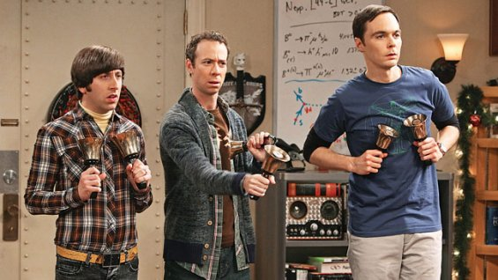
Getting to your goals (how to go about doing it)
Network efficiently
You need to be liked: social skills are important
Develop peer relationships
Connect to other researchers!
Do you inject energy and enthusiasm when you are in a group? Be positive!

Slide 9
Your are ALWAYS interviewing
You never know where the next potential employer, colleague, collaborator,… will come from.
When talking in public, when in conferences, when interacting with a visitor, when discussing with a fellow student… you are ALWAYS ON.
How to be always on: be competent, communicative, creative, and take initiative

Slide 10
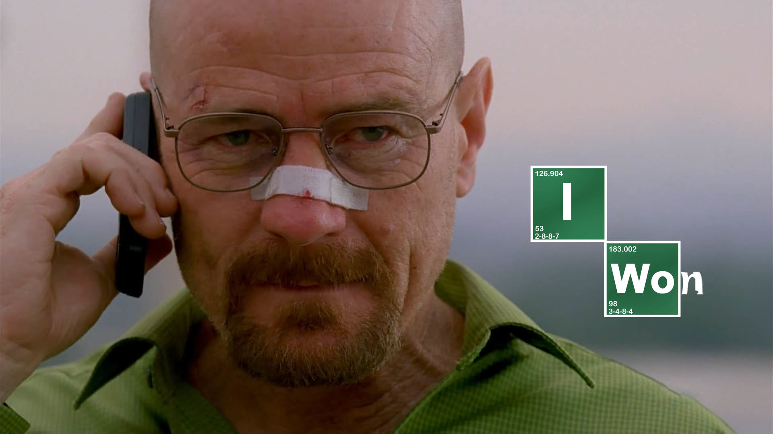
Self examining progress
Work on your weakness
Improve your strengths
Do it while you enjoy it! It is never too late to change

Slide 11
Research for Dummies
Step 1: Find a nice topic/problem that interests you, (work with your advisor)
Step 2: Read all you can find about that topic
Step 3: Write a formal/informal literature review
Step 4: Formulate the problem in technical/scientific terms
Make it more specific
Argue with yourself whether this is an interesting problem
Do you think your solution will help augment knowledge in the topic of your choice
Step 5: Solve the problem/ collect data/ draw inferences
Team up with your advisor to understand and analyze the data/solve the problem
Step 6: Do you have something interesting to report?, if not, return to 5
Step 7: You can now submit a paper

Slide 12
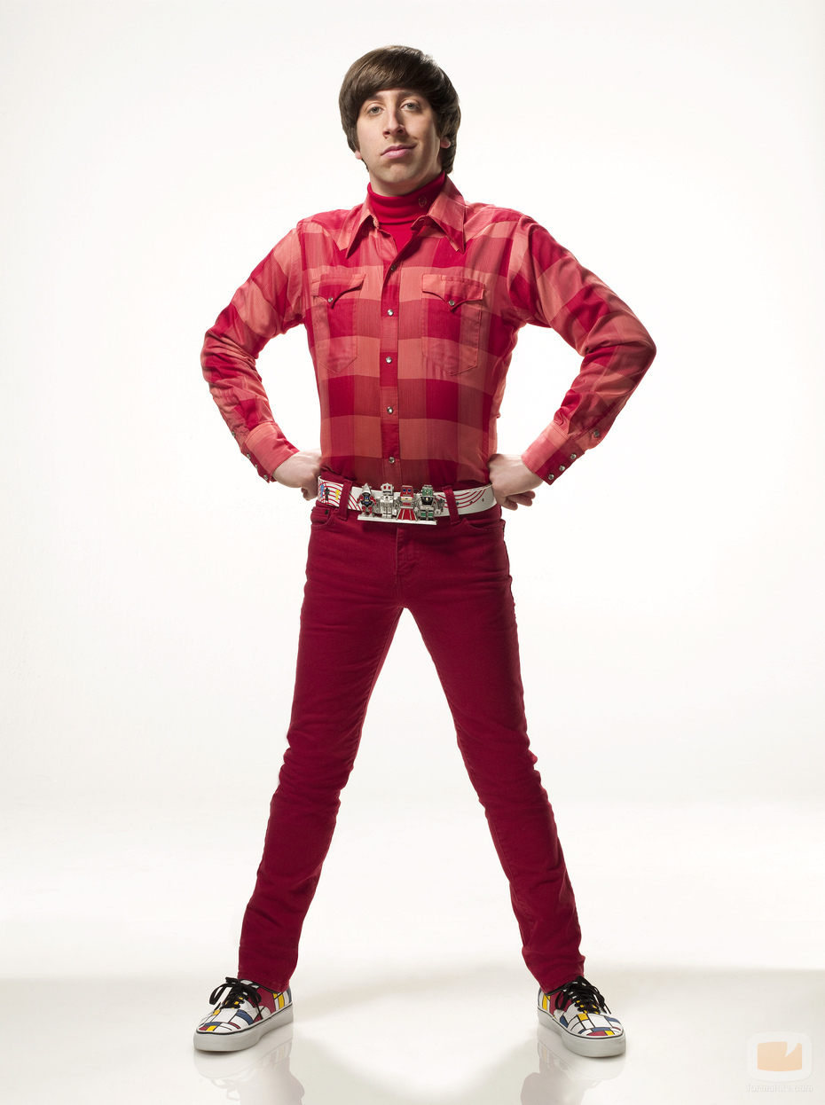
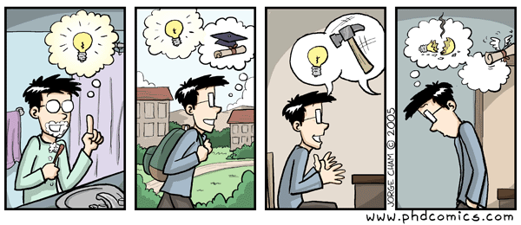
Research for Dummies
Loop breaker!!!
If nothing interesting after n repeated tries, return to step 1
Let’s say you have something to write about
Start the writing process early
Get help from writing services
Work with your advisor to improve paper

Slide 13
Reading Papers
You have to read a lot, how to do this effectively
Effective researcher's don’t read everything that’s out there!
Yes not even your advisor!!
Shortlist papers beforehand
Use Google Scholar, and other tools: citeseer etc.
Go to the library ask their help
Shortlist papers through their abstract
Use papers to find the next set of relevant papers
Go backward: who is the author citing
Go forward: who cited this paper
Make a list of authors that you want to follow, read their stuff whenever you get a chance

Slide 14
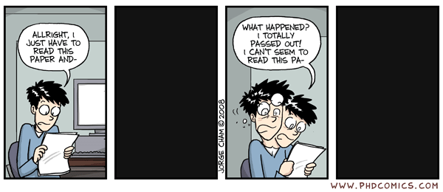
Reading Papers Critically
Questions to ask while reading papers:
What is the main point of the paper
What exactly is the contribution?
Is the contribution transformative or incremental?
What are the assumptions?
How can the contribution be made stronger?

Slide 15
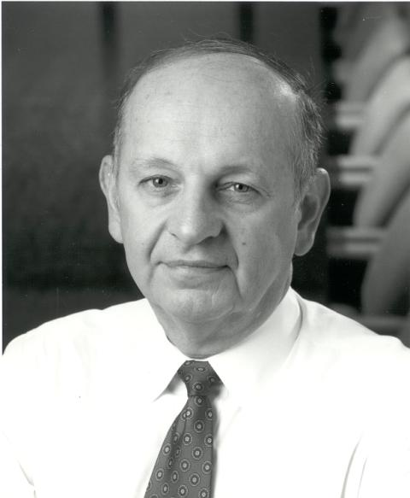
Heilmeir’s Caethesism
What are you trying to do? Articulate your objectives using absolutely no jargon.
How is it done today, and what are the limits of current practice?
What's new in your approach and why do you think it will be successful?
Who cares?
If you're successful, what difference will it make?
What are the risks and the payoffs?
How much will it cost?
How long will it take?
What are the midterm and final "exams" to check for success?

Slide 16
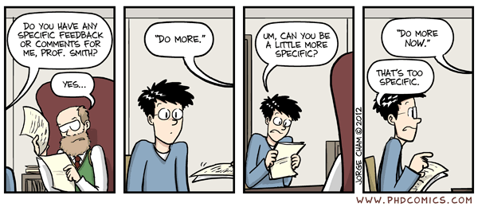
Making Progress
There is a big difference between WORKING and making PROGRESS
Stay focused
Argue your points confidently and consistently
Seek constant feedback and be responsive to criticism

